Slide 1



Peering Trend and Practice
Saw Yan Paing
CCIE #57005
MMIX | ARK Premium Solutions Limited

Slide 2


Brief History of Internet
In 1983, A new communications protocol was established called Transfer Control Protocol/Internet Protocol (TCP/IP).
  This allowed different kinds of computers on different networks to "talk" to each other.
  All networks could now be connected by a universal language.
1980s
In 1991, the Internet became available for public access.
1960s
  In 1989, Tim Berners-Lee, a British scientist, invented the World Wide Web (WWW).
1990s
The Internet started in the 1960s as a way for government researchers to share information.
  Publishing “ARPANET” in 1967.
  Proposed line speed 2.4 kbps to 50 kbps.
  In 1969, it initially connected four universities' computers to each other.

Slide 3

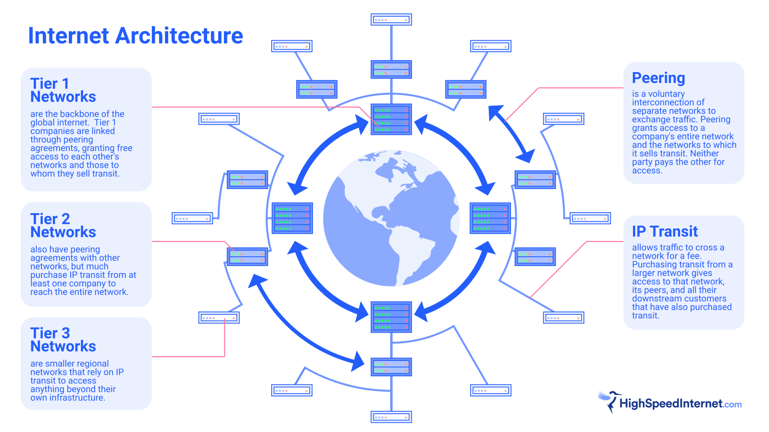


Slide 4
The Global Internet Peering Ecosystem
AU Internet Region
EU Internet Region
Japan Internet Region
US Internet Region
Tier 1 ISPs
Tier 2 ISPs
Content Provider
The Global Internet Peering Ecosystem consists of a set of interconnected internet regions (Countries).

Slide 5

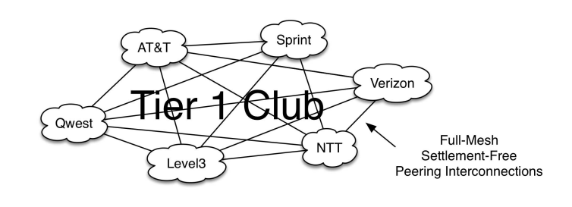
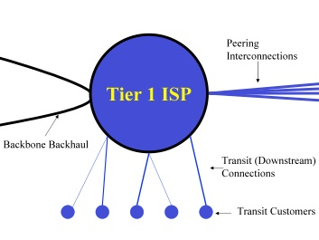
Tier 1 ISPs
Peering Motivation
  Tier 1 ISPs don’t pay transit fees, so they are only motivated to peer with each other as a way to provide connectivity for their customers.
  Generally, Tier 1 ISPs don’t want to peer with non-Tier 1 ISPs.
Tier 1 ISP Peering Interconnections
Peering Policy
  Most Tier 1 is seen as Restrictive Peering Policies.
Reference
Qwest - http://www.qwest.com/legal/peering_na.html
AT&T - http://www.corp.att.com/peering/
Verizon - http://www.verizonbusiness.com/terms/peering/
Tier 1 ISP Model

Slide 6
Case Study
International Story. For example, a large international ISP built into Brazil and was able to negotiate peering with the dominant regional Tier 1 ISPs, with the argument that it did not represent a serious threat to their home market, and that the free access to its international customers would be beneficial. Once established in that region, the international ISP obtained transit contracts with a few customers within the region, and that traffic traversed the peering connection.
Telecom Italia. One exception to the Regional Tier 1 ISPs doesn’t peer rule exists in Italy. Telecom Italia is a formerly state-owned telephone company and Regional Tier 1 ISP in Italy. They peer openly in the region, preferring one interconnect point, but accepting multiple if the peer prefers. This is exactly the opposite of every story heard elsewhere in the world.
Source: drpeering.net

Slide 7
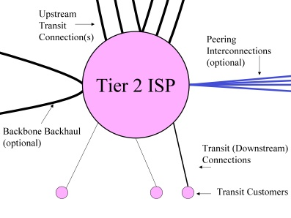
Tier 2 ISPs
Tier 2 ISPs need to purchase Transit to access some part of the internet regions.
Peering Motivation
  Tier 2 ISPs motivate to peer in region to reduce the transits cost.
Peering Policy
  “Open” Peering or “Selective” Peering Policy
Tier 2 ISP Model
Reference
Example of Open Peering Policies
CAIW Netwerken - http://www.as15435.net/pp/
WISCNet - http://www.eng.wiscnet.net/peering/
NetAccess : http://www.nac.net/eng/peering.asp
Example of Selective Peering Policies
peer1 - http://www.peer1.com/infrastructure/peering.php
Bouygues Telecom - http://peering.as5410.net/
BT - http://www.bt.net/info/peering.shtml
EasyNet - http://www.noc.easynet.net/network/public/peering.php
AboveNet - http://www.abovenet.com/peering/
Comcast - http://www.comcast.com/peering/

Slide 8
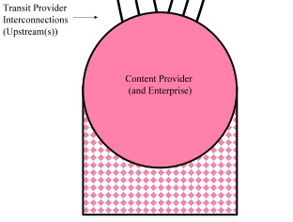
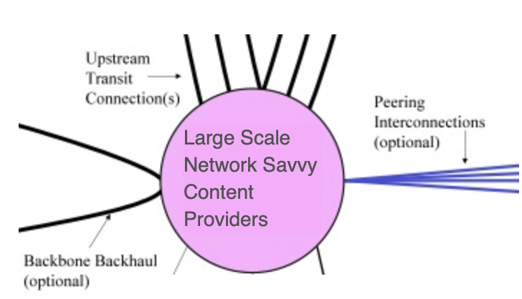





Content Provider
Traditional content Provider : focuses on content development and does not Sell access the Internet.
Peering Motivation
  SLAs w/well known ISP
Peering Policy
  “No Peering” Policy
Large Scale Network Savvy Content Providers : are the group of Content Providers that have adopted Peering as a strategy for lowering traffic expenses, increasing their ability to control and improve the end-user experience.
Content Provider Model
Peering Motivation
  Similar motivations to peer with Regional Tier 2 ISPs
Peering Policy
  “Open Peering” Policy

Slide 9
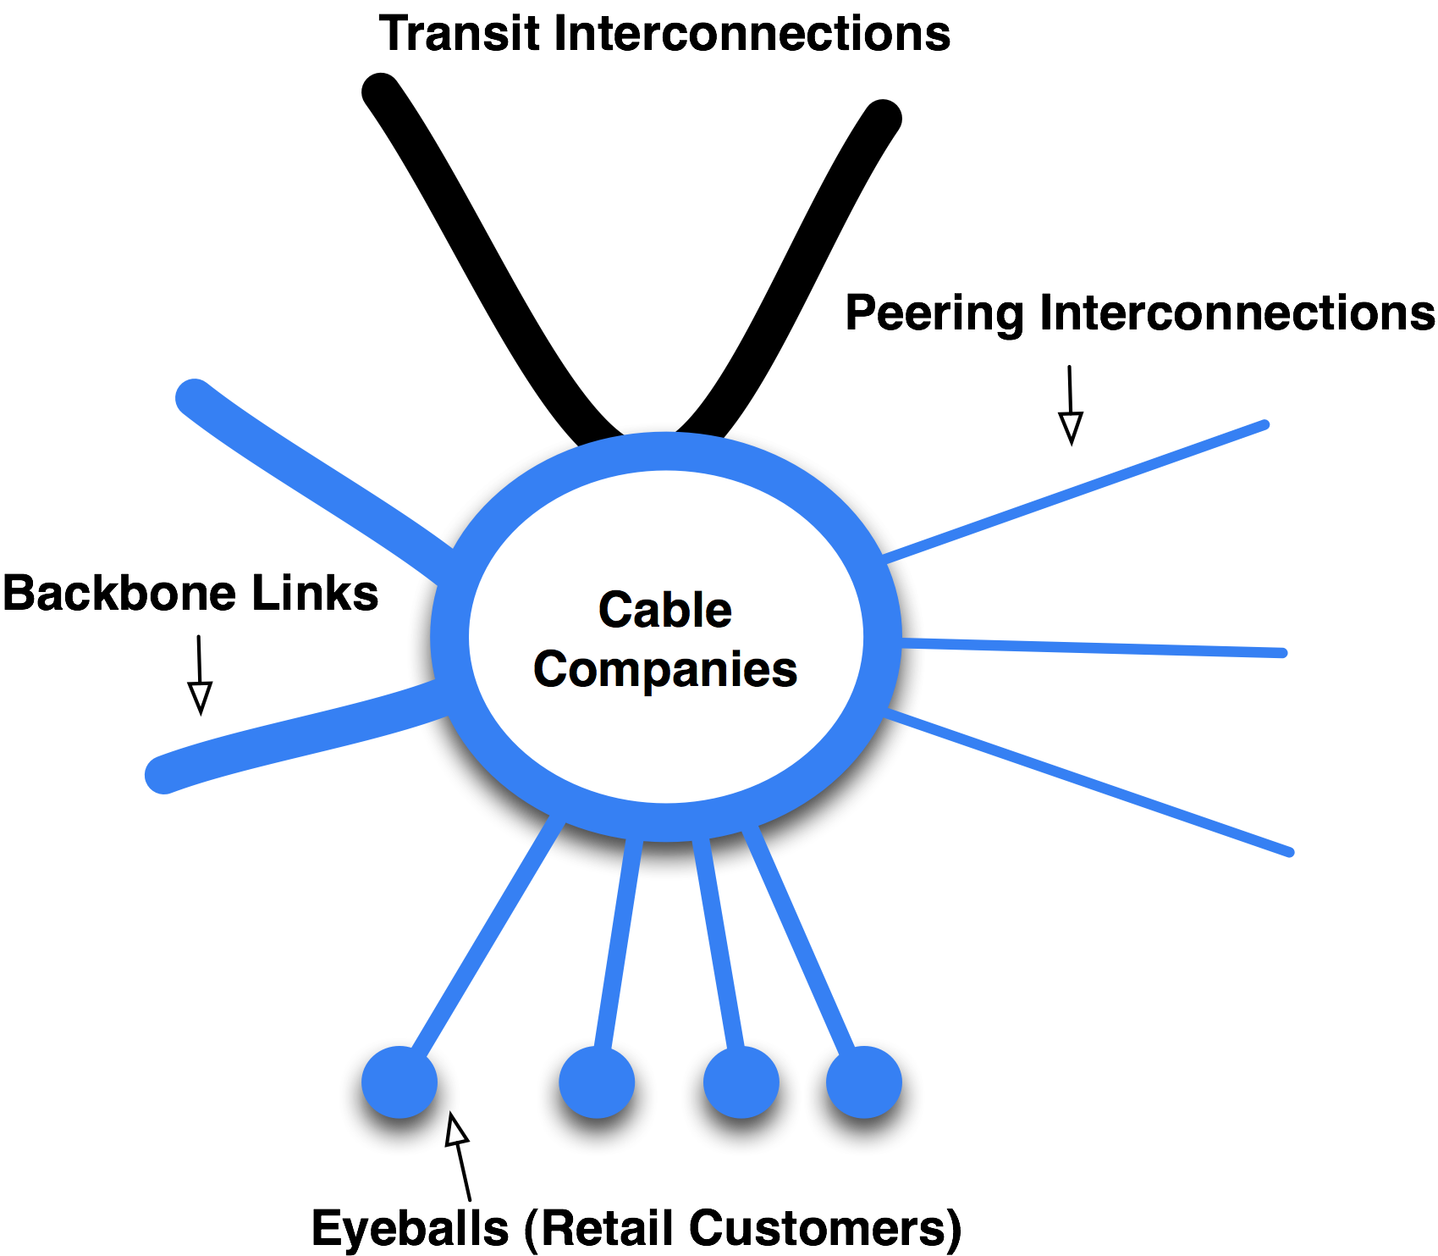
Cable Companies , aka Broadband Internet Service Provider
  The cable company are regional and don’t tend to compete in overlapping areas, and they tend to pull enormous volumes of traffic.
Peering Motivation
  Similar to Tier 2 ISPs, motivate to peer to reduce transits cost, avoid Internet transits traffic congestion, better customer experience
Peering Policy
  “Open Peering” Policy
Cable Company Model

Slide 10
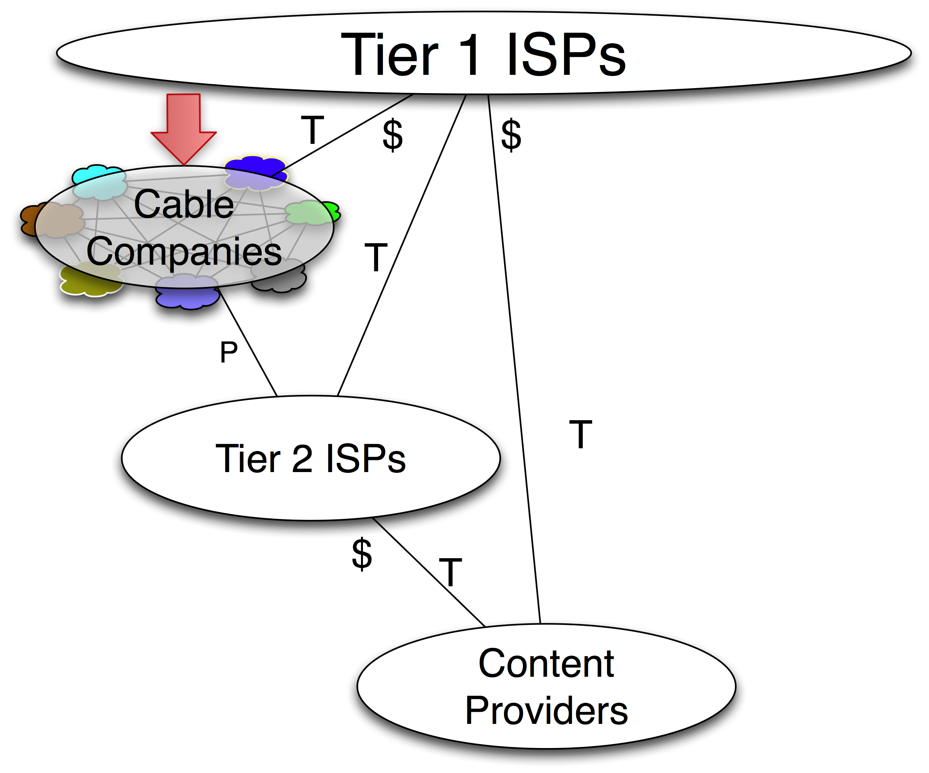
The cable companies emerge as independent players.

Slide 11
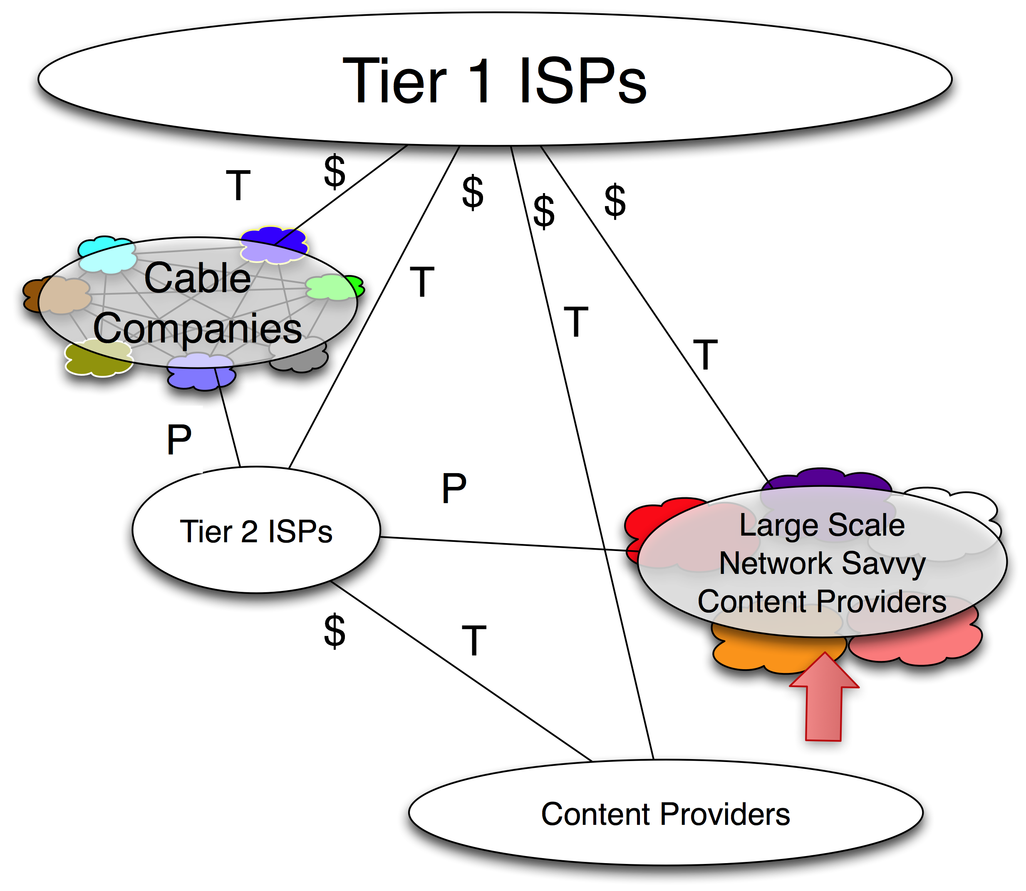
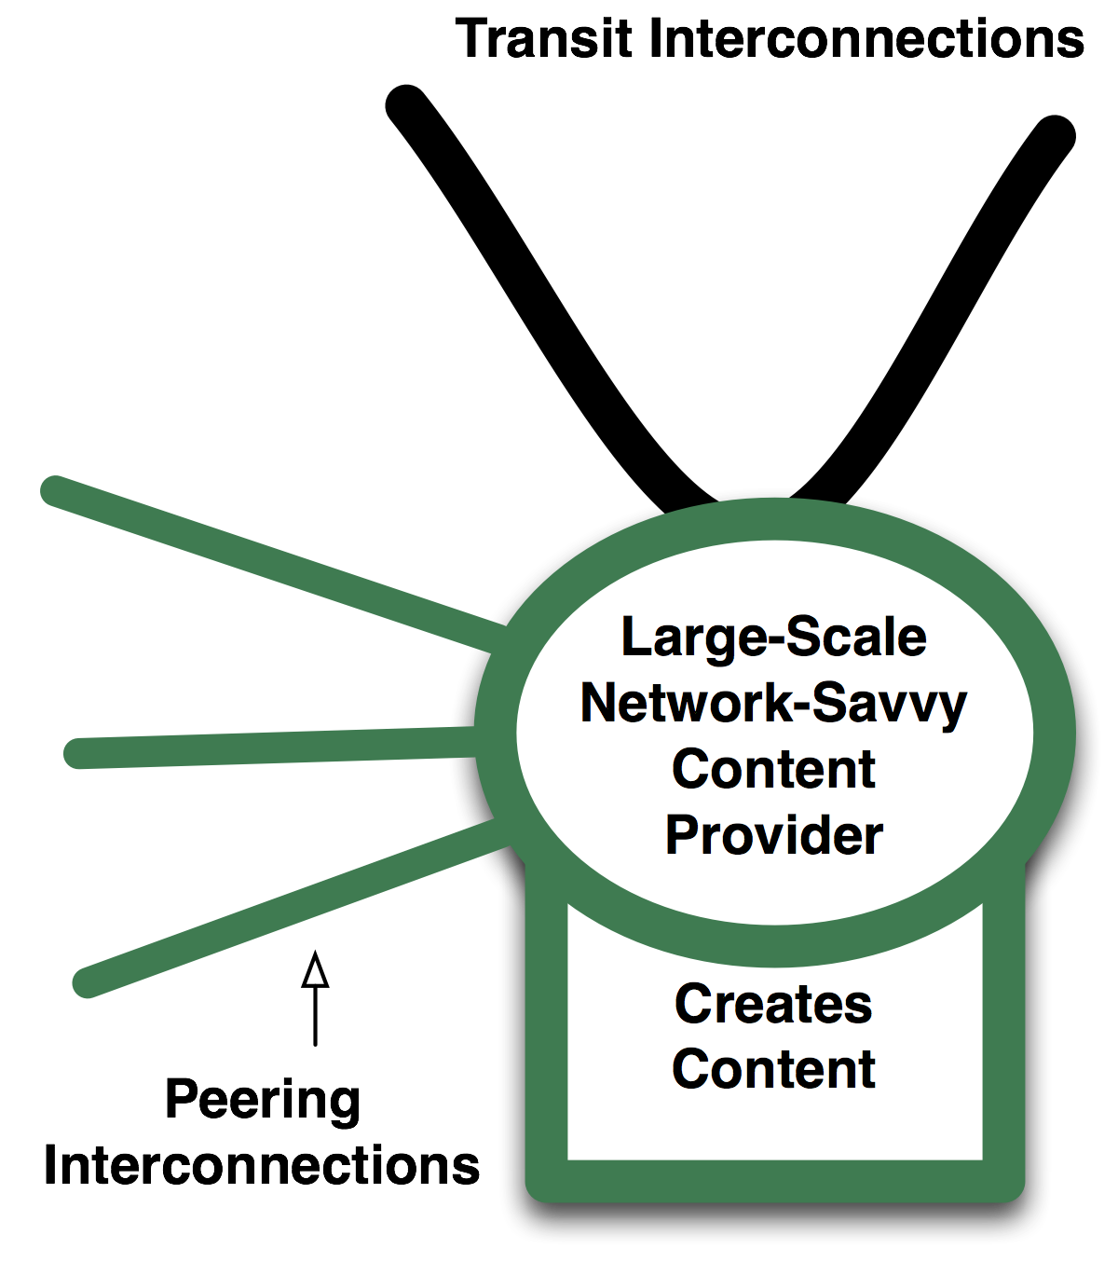
The Large-Scale Network-Savvy Content Providers peer openly.

Slide 12
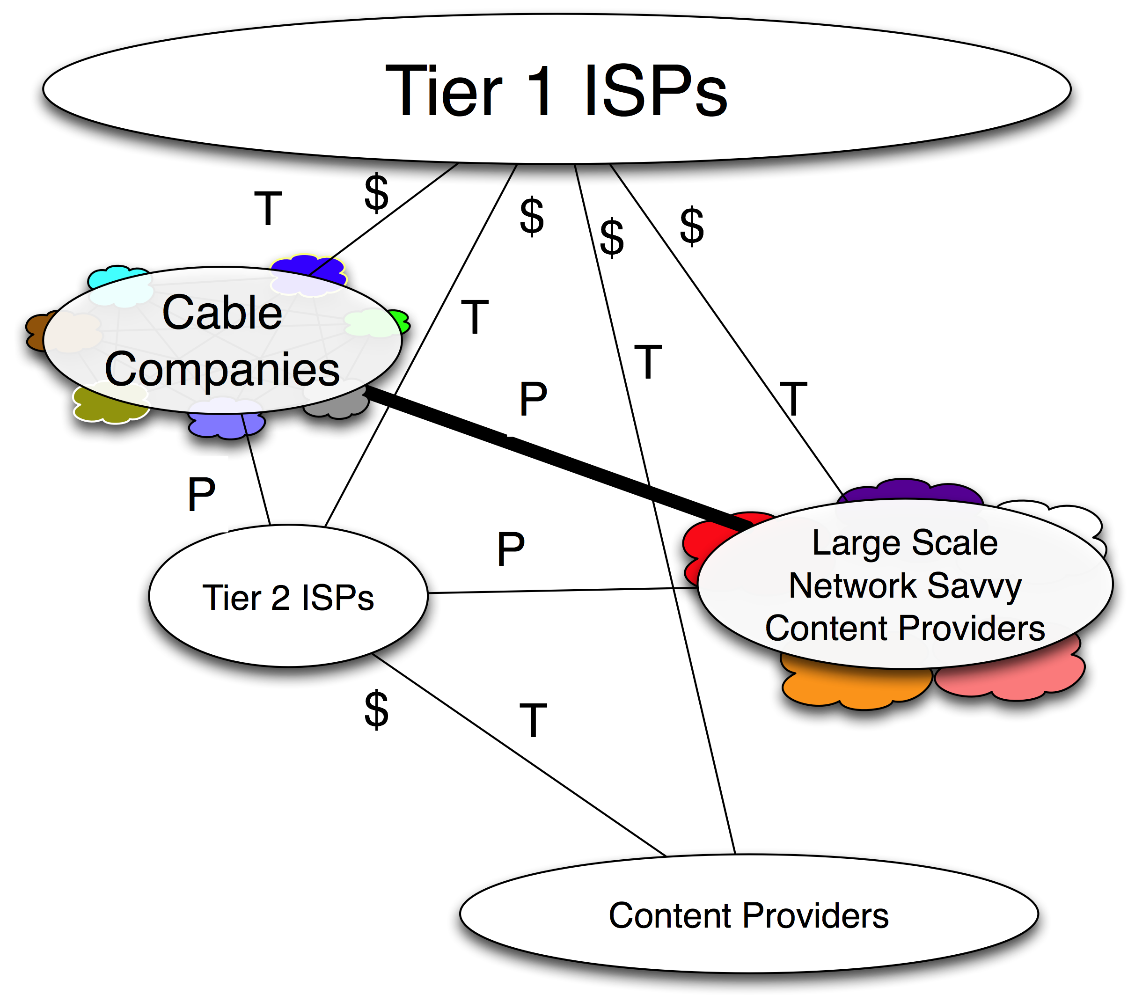
Content peers with eyeballs. The Tier 2 ISPs and the cable companies peer with the content companies that entered the peering ecosystem.

Slide 13
Content peers with eyeballs. The Tier 2 ISPs and the cable companies peer with the content companies that entered the peering ecosystem.

Slide 14
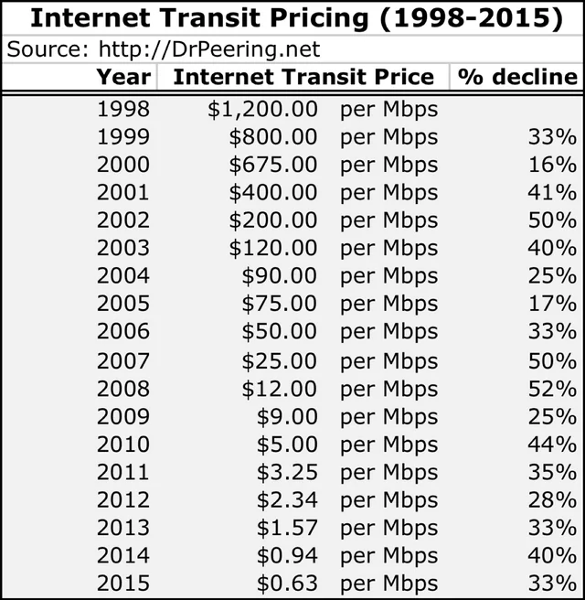
Global Internet Transit Price Trend
Transit price dropped an average of 30% per year.
Internet traffic has historically grown by 40–50% per year.
  “Internet Transit is so inexpensive, why do we need anything else?”

Slide 15
  “Internet Transit is so inexpensive, why do we need anything else?”
  Without Peering, Packets will travel the Ocean. Twice!

Slide 16
Advantages of Peering
Peering is significantly cheaper than IP Transit and will help you to reduce IP Transit costs.
Peering will give you direct access to many Content and Eyeball networks.
Peering leads to shorter AS paths and helps to improve your profile in a competitive market environment.
Peering allows direct control over the traffic flows.
Peering make the Internet robust and reliable.
Peering is where the Internet lives.

Slide 17
Peering Rollout
Connect to Reginal IX
Define your own peering policy
Do not stop to explain to difficult to peer targets why Peering does make sense

Slide 18
Peering Policies
”Open” Policy
Peer with everyone, regardless of type of provider
Mainly used by all kinds of Content Providers/Content Delivery Networks and many Tier 2, and Tier 3 Provider

Slide 19
Peering Policies
”Selective” Policy
ISP will only peer with another ISP that does meet the prerequisites listed in a Peering Policy ( Example: Minimum traffic , Coverage, Number of routes announced)
Mainly used by bigger Tier 2 providers

Slide 20
Peering Policies
”Restrictive” Policy
Peer with a very limited number of networks.
Typically don’t want to add more Peers

Slide 21
Thank You

