Slide 1
Setting up Simple Anycast DNS Recursive
Resolver for an ISP
Saw Yan Paing
CCIE# 57007
MMIX

Slide 2

What is DNS?
Resolve a fully qualified domain name (FQDN) to an IP Address IPs.
hierarchical and decentralized naming system.
Example FQDN : www.google.com.
Hostname
Domain Name
TLD
Root Servers

Slide 3

Naming Hierarchy
ICANN
root
Registries
MMIX
net
com
edu
gov
org
mm
etc.
mm-ix
mmnog
Top Level Domain (TLDs) are at the top
Maximum tree depth: 127
Each Domain Name is a subtree
Example: .net -> mm-ix.net -> lg.mm-ix.net -> api.lg.mm-ix.net
Name collisions are avoided
lg
libre
ixpmanager
api
www
Tree is divided into Zones
  Each zone has an administrator
  Responsible for the part of the hierarchy
Example:
MMIX controls *.mm-ix.net
MMNOG controls *.mmnog.net

Slide 4
Without DNS…….?
How could you get any websites?

Slide 5
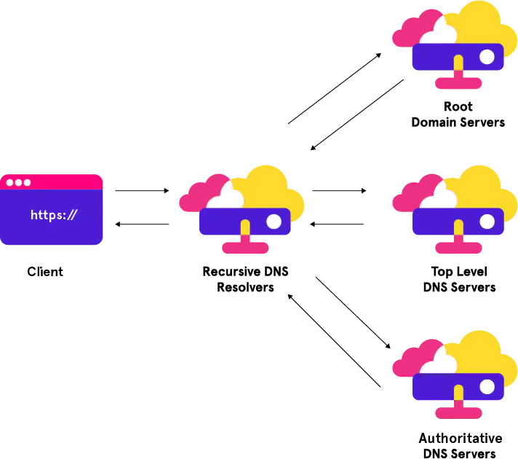
Types of DNS servers
Recursive resolver
DNS root name server
TLD name server
  generic TLDs (gTLDs)
  Sponsored TLDs
  Non-sponsored TLDs
  Country Code TLDs (ccTLDs)
  Internationalized TLDs
Authoritative name server

Slide 6



What is a Recursive DNS Server?
A recursive DNS server, also known as a recursive resolver or simply a resolver, is a fundamental component of the Domain Name System (DNS) infrastructure.
It’s is responsible for resolving the query. It starts by querying the root DNS servers, which point it to the appropriate Top-Level Domain (TLD) DNS server. The TLD server then directs the recursive server to the authoritative DNS server for the specific domain.

Slide 7
Recursive DNS Server's Mission:
Is to efficiently and reliably resolve domain names to their corresponding IP addresses.
It is emphasized that Name resolution, Caching, Query forwarding,...etc.
Describe it as the essential intermediary that makes internet navigation seamless for users.

Slide 8
Here’s the example picture how “Recursive DNS Server” works:
“.” Root Servers
https://www.google.com.
x.x.x.x
Top Level DNS Servers
Recursive Server
Authoritative DNS Servers
https://www.google.com = x.x.x.x.

Slide 9
Different between
“Authoritative DNS Server” and “Recursive DNS Server”
 | Authoritative DNS Server | Recursive DNS Server
Function | Provide official DNS records for a particular domain | Help resolve domain names to IPs by querying authoritative DNS servers.
Responsibility | Store and maintain DNS records for the domains | Don't store official records; they retrieve and cache info from authoritative servers.
Queries | respond to queries about specific domains with the accurate DNS records. | Issue queries to authoritative DNS servers to find the IP address associated with a domain.
Caching | don't typically cache records for other domains | Cache the results of queries to speed up future lookups.

Slide 10





Advantages of
“ Local Recursive Resolver”
Efficient Name Resolution
Reduced Network Traffic
Improved User Experience
Load Balancing &
Redundancy
...etc.

Slide 11
What is Anycast?
Network routing method!
  Multiple routing paths to a group of endpoints that are each assigned the same IP address.
Route to one of several destinations / one-to-one-of-many association.
  Routing is determined by one of two schemes:
    Network Layer Anycast scheme: the router selects a destination optimal for the user and provider, based on number of hops.
    Application Layer Anycast scheme: the router may also take into account additional calculations, such as server availability, time to response, number of connections, and so on.

Slide 12
Why use Anycast with DNS?
With Anycast DNS, we can enable a group of DNS servers with single IP address, to respond to DNS queries based on the geographical location of a DNS client.
Benefits of the DNS anycasting:
  Enhancing DNS response time
  Simplify DNS client settings
  Extra layer of redundancy
  Protect against DNS denial of service attacks

Slide 13
Anycast for Recursive DNS resolver
ISPs can use anycast for recursive DNS resolver to improve the speed and reliability of their customers’ Internet browsing experience.
By anycasting, ISPs can allow all of their customers to configure a single IP address that will reach the nearest recursive DNS server, and seamlessly failover to the next closest server in the event of a location fails or is taken offline.

Slide 14

Advantages of running anycast on recursive DNS servers
Running anycast on recursive DNS servers provides several advantages that enhance the performance, availability, and reliability of DNS services. Anycast is a network addressing and routing technique that allows multiple servers located in different geographic locations to share the same IP address.
Load Distribution
Proximity-based Routing
High Availability
Scalability
Cost Efficiency
Simplified Configuration
……etc.

Slide 15
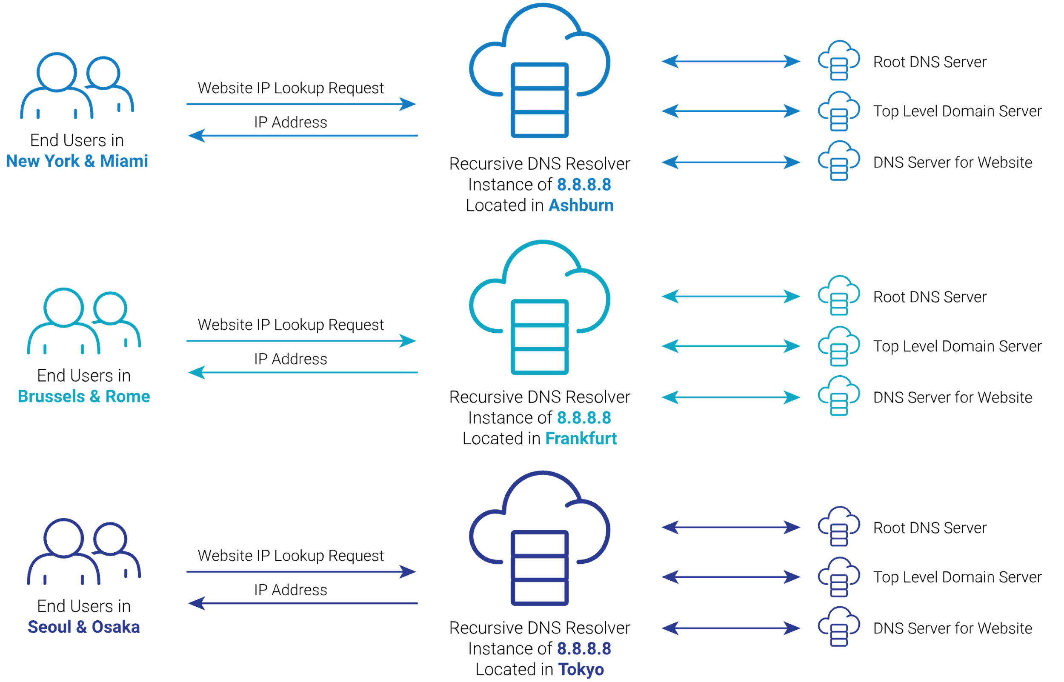
Anycasting of the well-known public recursive DNS service

Slide 16
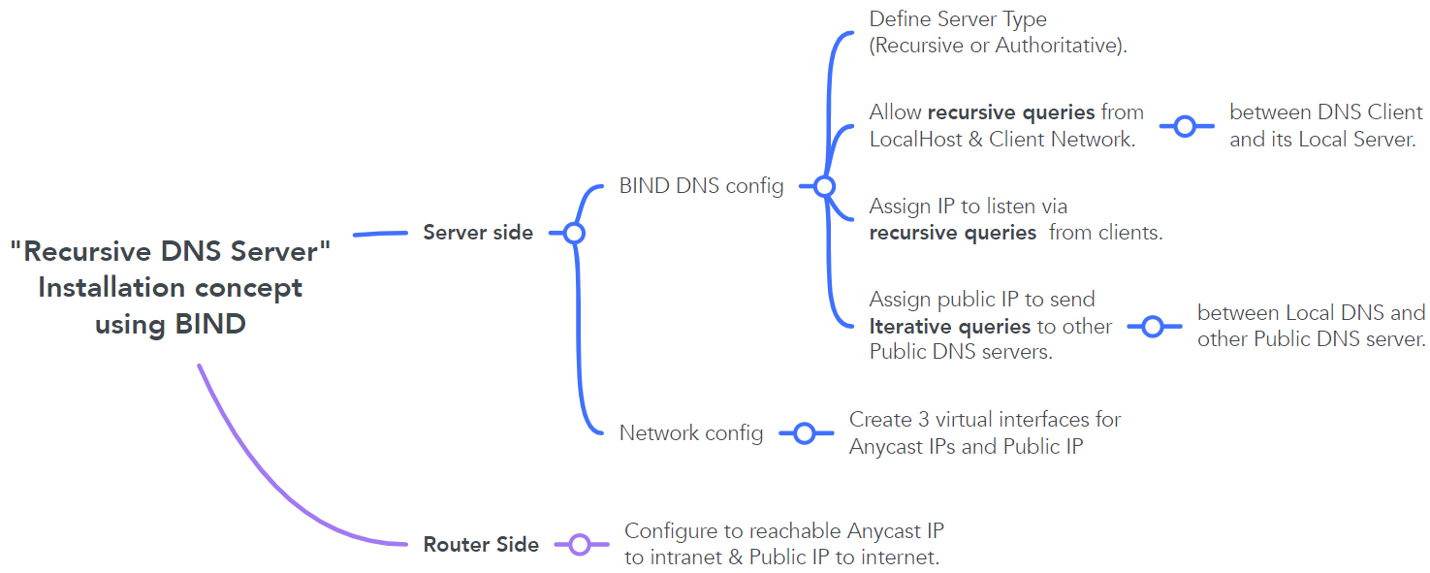
Recursive DNS Server Installation concept.

Slide 17


Recursive DNS Server Installation concept.
recursion
- To define Authoritative server or Recursive DNS Server.
allow-query
- To allow who can query the domain to this server.
listen-on
- To listen client DNS queries
query-source
- To send query to another DNS server.

Slide 18
Recursive DNS Server Installation Example.
Network Configuration
$ IP addr
ens3: <BROADCAST,MULTICAST,UP,LOWER_UP> mtu 1500 qdisc fqcodel state UP group default qlen 1000
link/ether 00:50:01:00:16:00 brd ff:ff:ff:ff:ff:ff
inet 172.16.1.2/24 brd 172.16.1.255 scope global ens3
valid_lft forever preferred_lft forever
inet6 fe80::250:1ff:fe00:1600/64 scope link
valid_lft forever preferred_lft forever
any10.vip: <BROADCAST,NOARP,UP,LOWER_UP> mtu 1500 qdisc noqueue state UNKNOWN group default qlen 1000
link/ether 0e:f0:e8:74:2e:69 brd ff:ff:ff:ff:ff:ff
inet 10.10.10.10/32 scope global any10.vip
valid_lft forever preferred_lft forever
inet6 fe80::cf0:e8ff:fe74:2e69/64 scope link
valid_lft forever preferred_lft forever
any11.vip: <BROADCAST,NOARP,UP,LOWER_UP> mtu 1500 qdisc noqueue state UNKNOWN group default qlen 1000
link/ether 3a:e7:76:ec:28:13 brd ff:ff:ff:ff:ff:ff
inet 11.11.11.11/32 scope global any11.vip
valid_lft forever preferred_lft forever
inet6 fe80::38e7:76ff:feec:2813/64 scope link
valid_lft forever preferred_lft forever
public.vip: <BROADCAST,NOARP,UP,LOWER_UP> mtu 1500 qdisc noqueue state UNKNOWN group default qlen 1000
link/ether 22:94:a7:80:e7:e2 brd ff:ff:ff:ff:ff:ff
inet 103.103.1.1/32 scope global public.vip
valid_lft forever preferred_lft forever
inet6 fe80::2094:a7ff:fe80:e7e2/64 scope link
valid_lft forever preferred_lft forever

Slide 19
Recursive DNS Server Installation Example.
Bind DNS Configuration
/etc/bind/named.conf.options
options {
directory "/var/cache/bind";
recursion yes; // allow recursive queries
allow-query { localhost; 172.16.255.0/24; }; // allow queries from localhost and client network
listen-on { localhost; 10.10.10.10; 11.11.11.11; }; // allow server IPV4 address to listen DNS queries from client
query-source 103.103.1.1; //Specific IP address for DNS Server Outbound Query
dnssec-validation auto;
listen-on-v6 { any; };
};
logging{
channel query logging {
file "/var/log/named/query.log" versions 3 size 10m;
severity debug 3;
print-time yes;
print-severity yes;
print-category yes; };
category queries {
query logging; };
};

Slide 20
summary
What is “Recursive DNS Server”
How does it work.
Advantages of Local Resolver.
Different between Authoritative & Recursive DNS server.
Advantages of enabling Anycast on DNS service.
Recursive DNS server installation concept and example configuration using by BIND DNS software.

Slide 21
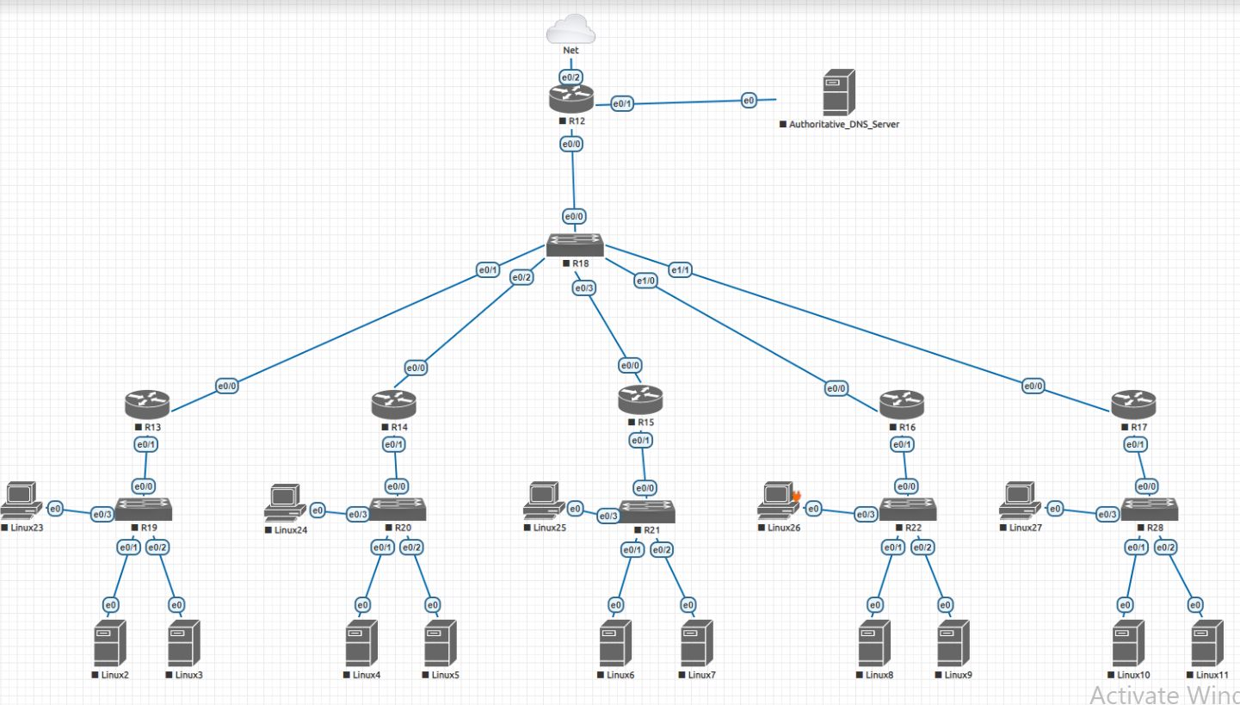

Slide 22
Thank you

