Slide 1
Team Cymru
Community Services
The “What/Why/How”
Team Cymru

Slide 2
Introductions
Who is Team Cymru?
Overview of Community Services
Bogons
AGENDA
UTRS™ (DDOS mitigation service)
NIMBUS™ Threat Intelligence
DNB, Dragon News Bytes
IP to ASN Mapping Tools
MHR, Malware Hash Registry
CAP, CSIRT Assistance Program

Slide 3
INTRODUCTIONS

Slide 4
Team Cymru
Who we Are
We uncover the who, what, when, where and why of malicious behavior.
15+ years of service to network defenders, internet operators and cybercrime investigators worldwide.
Free services for ISPs, hosting providers and CSIRTs
Unmatched eco-system of data sharing and collaboration partnerships worldwide
Work with 140+ CSIRT teams in 86+ countries
Relied on by many security vendors, Fortune 100 companies, and public sector teams.
CSIRT
Events
Team Cymru is comprised of former…
Members of national and industry CSIRT teams
Law enforcement
Analysts from research, education, private and public sectors
ISP backbone engineers
Fortune 500 enterprise network engineers
Penetration testers
Military – US and allied nations
Frontend, backend, gaming, web app, kernel, high-performance computing and big data developers and system engineers
Free Tools
DNB

Slide 5
Outreach
Free Tools
Solutions provided by Team Cymru
Nimbus Threat Monitor: Kibana-based appliance that integrates our insight about malicious activity on your network, with near real time alerting
CSIRT
Events
Unwanted Traffic Removal Service (UTRS): A system that helps mitigate large infrastructure attacks by leveraging an existing network of cooperating BGP speakers such as ISPs, hosting providers and educational institutions that automatically distributes verified BGP-based filter rules from victim to cooperating networks.
IP To ASN Mapping Project: A query interfaces that allow for the mapping of IP addresses to BGP prefixes and Autonomous System Numbers (ASNs), based on BGP feeds from our 50+ BGP peers. Updated every 4 hours, this data is available through traditional WHOIS (TCP 43), DNS (UDP 53), HTTP (TCP 80), and HTTPS (TCP 443).
Community Services
Malware Hash Registry (MHR): Similar to the Team Cymru IP address to ASN mapping project, the Malware Hash Registry (MHR) project is a look-up service with an added benefit: you can query our service for a computed MD5 or SHA-1 hash of a file and, if it is tracked malware, we return the last time we have seen it along with an approximate anti-virus detection percentage.
Free Tools
DNB

Slide 6
Outreach
CSIRT Assistance Program
Free Threat Intel for Non-Commercial National and Regional CSIRT Teams.
CSIRT
Events
Team Cymru works with national and regional CSIRT teams globally by sharing our world-class threat intelligence. We provide this unique Pure Signal™ intelligence at no cost to you. We want to help secure the Internet, and we want to keep you informed of what we see in your region
We provide intelligence on a variety of categories:
Bots / Controllers
Honeypot
Scanners
Community Services
Brute-Force
Open Resolvers
Spam
Darknet
Phishing
Proxies
Free Tools
DNB

Slide 7
Outreach
Events
Team Cymru Conferences
We hold a series of Regional Information Security Events (RISE), as well as an annual conference called Underground Economy. These are exclusive events, centered on threat intelligence, cyber crime and cyber security issues, that include TLP-Amber and -Red case studies. In order to register for one of these events, please apply via the links below, and we will contact you with further instructions.
CSIRT
Events
Team Cymru Webinars
We have a ongoing series called ‘Dragons Den’ where we talk with industry experts about current trends, participate in and sponsor regional events (e.g PacNOG), and host webinars around the globe to help keep communities up to date on what we are working on and seeing in the world of information security / intelligence.
Community Services
Event Schedules
Free Tools
DNB
Visit our events page https://team-cymru.com/company/events/ follow us on Twitter @teamcymru and LinkedIn https://www.linkedin.com/company/team-cymru/

Slide 8
Outreach
Dragon News Bytes
Curated Information Security News provided by Team Cymru
Dragon News Bytes is a private and restricted mailing list that distributes Information Security news articles. These articles may come from newspapers, magazines, and other online resources, as well as from Team Cymru’s own research.
CSIRT
Events
We will endeavor to tag the subject line with [DNB] and at least one other tag to suggest the topic:
[APT] – Advanced Persistent Threat, Nation State hacks and malware
[ARREST] – News of arrests, court matters and sentencing for InfoSec criminals
[ATTACK] – DDoS, defacements and criminal ‘hacks’
Community Services
[HACKTIVISM] – Anonymous, #OpAnything plus anything related to online protests
[MALWARE] – Viruses, botnets and other stuff we know you love
Free Tools
DNB
[MOBILE] – Anything related to Android, iOS Security
[POLICY] – Anything related to InfoSec policies, guidance and procedures
[PRIVACY] – Related to anything that impacts your personal privacy, OPSEC, data breaches, and information disclosures
[RESEARCH] – Papers and other new analysis and insight
[TIPS] – Anything else we can’t categorize otherwise
[VULNS] – Anything related to vulnerabilities, patching, etc

Slide 9
BOGON’s

Slide 10
BOGON’s Module Overview
What are BOGON’s ?
What problem(s) are we helping to solve ?
Requirements to signup for the BOGON Service.
How to signup for the BOGON Service.
How to implement BOGON Service on your network.
Questions ?

Slide 11
What are BOGON’s
BOGON’s are netblocks that should not be reachable or routable on the public internet.
The following are part of the Basic BOGON’s dataset:
  RFC 1918, RFC 5735 and RFC 6598
  IP address blocks that have not been assigned to a RIR
The following make up our Full BOGON’s dataset:
  All the addresses in the Basic BOGON dataset
  RIR address blocks that are currently not allocated or assigned
Notes:
Bogons
Bogons are defined as Martians (private and reserved addresses defined by RFC 1918, RFC 5735, and RFC 6598) and netblocks that have not been allocated to a regional internet registry (RIR) by the Internet Assigned Numbers Authority.

Slide 12
What problem are we helping to solve
Internet routers that face the public internet should only forward traffic with valid IP’s
Manually maintaining filters (ACL’s) and keeping them updated is a time consuming and error prone task. Cymru Bogon’s solves this.
We provide a unified and validated near realtime list of IP addresses that should NOT be reachable on the public internet.
We provide this via BGP, DNS, and HTTPS (wget txt data)

Slide 13
Requirements to signup for BOGON’s
Data via HTTPS or DNS does not require any signup.
Data via BGP feed requires the following signup information:
  Full Name
  ASN and Peering IP
  Email and Company Name
  Router that can handle up to 250,000 prefixes and eBGP Multi-Hop

Slide 14
How to signup for BOGON’s service
For the BGP feed goto the following link and complete the form
https://www.team-cymru.com/bogon-networks
You will need your complete name, company name, email address
You will also need your public ASN and the IP address you wish to peer with.
Once you submit this information, our staff will review and validate the information. If everything is in order you will get an email with the BGP peering details.

Slide 15
How to implement BOGON’s in your network
Implementing BOGON’s in your network is pretty straight forward.
For HTTPS / DNS methods you will need to integrate these queries into your existing tools. The specifics are ICB
For BGP integration, you will create a BGP neighbor session on your router and setup a route-map or prefix filter that tags the incoming route announcements so those routes goto /dev/nul
We have lots of examples available on our web site.

Slide 16
QUESTIONS ?

Slide 17
NIMBUS™
Network Threat Intelligence

Slide 18
NIMBUS™ Module Overview
What is NIMBUS?
What problem(s) are we helping to solve ?
Requirements to signup for the NIMBUS Service.
How to signup for the NIMBUS Service.
How to implement NIMBUS Service on your network.
Questions ?

Slide 19
What is NIMBUS™
NIMBUS is Team Cymru’s ISP and Hosting Company focused Threat Intelligence system.
We take our unique and one of a kind IP reputation data and automatically correlate it with your network flows.
This then enables us to tell you about malicious traffic on your network.
https://www.team-cymru.com/nimbus-threat-monitor

Slide 20
What is NIMBUS
Clients access the real-time threat information via a Kabana web interface.
Using Kabana allows you, the user to customize your dashboards, enabling you to see the information most important to you.

Slide 21
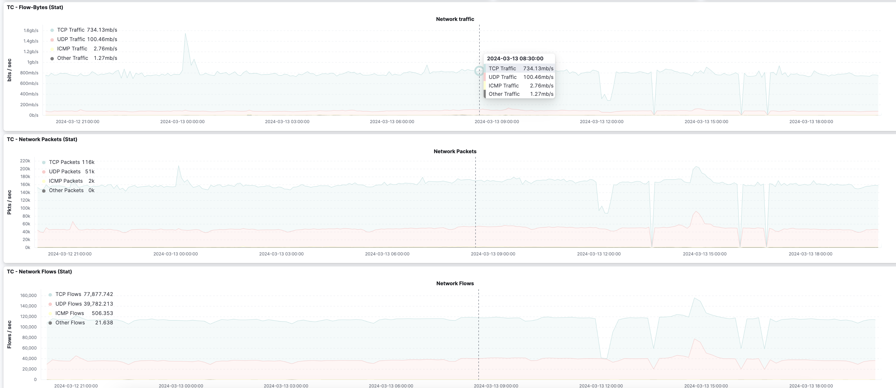

Slide 22
What problem(s) are we helping to solve?
Team Cymru NIMBUS helps solve the following kinds of problems
  Quickly identify compromised hosts on your network
  Who is consuming valuable bandwidth for malicious purposes ?
  Prioritize remediation based on our near real-time information
  Protect your customers
  Reduce operational costs and improve your brand.
All of this and more at no-cost to our partners.
When you join NIMBUS you join a unique community that is focused on helping save and protect human lives!
Become an Internet Hero!!

Slide 23
Requirements to signup for NIMBUS
You must be a network operator
You must have a publicly assigned ASN by your RIR
You must be running BGP on your network
You must be able to export netflow records

Slide 24
How to signup for NIMBUS
Signing up for NIMBUS is straight forward:
  Goto the web site https://www.team-cymru.com/nimbus-signup
  Complete the form with the following information:
    First and Last Name
    Company Name
    Your company email address (generally we do not accept free email addresses)
    Mobile Phone number (for our realtime WhatsApp notifications / support)
    Job Title
    Public ASN as allocated by your RIR
    You need to agree to our Terms and Conditions
Once the form is submitted our team will validate the information and quickly get back to you via email

Slide 25
How to implement NIMBUS in your network
Once you are approved for NIMBUS implementation is easy.
You will configure your network edge / border router to export network flow information to our cloud-based collector.
Once we see flow records arriving, we will then provide you with the control panel login credentials.
It is important that we see flows within 5 calendar days after approval or the session may be deleted, and you would have to start over.
We will then schedule a training session via Zoom

Slide 26
QUESTIONS ?

Slide 27
Dragon News Bytes
Curated Cyber Security News and Information

Slide 28
DNB Module Overview
What Dragon News Bytes?
What problem(s) are we helping to solve ?
Requirements to signup for the DNB Service.
How to signup for the DNB Service.
How to implement DNB Service on your network.
Questions ?

Slide 29
What is Dragon News Bytes
Dragon News Bytes is a private and restricted mailing list that distributes Information Security news articles. These articles may come from newspapers, magazines, and other online resources, as well as from Team Cymru’s own research.
https://www.team-cymru.com/dnb

Slide 30
What problem are we helping to solve?
Sorting thru the high volume of news and information articles
Get you actionable, current, relevant news and related information quickly.
Our team sifts thru hundreds of research papers, articles, press releases, breach notices, data dumps, etc. each day looking for and sorting this information into condensed posts.
Think of it like a President’s Daily Brief, it’s a summary with links to the details.
We give you the BLUF (Bottom Line Up Front)

Slide 31
Requirements to signup for DNB
In order to signup for DNB you need to complete an application.
Generally, you must signup from a corporate email address.
Your application will be vetted by our team.
Once approved you will begin to receive email from DNB.

Slide 32
How to signup for Dragon News Bytes
Signing up is very straight forward and takes just a couple of minutes.
Goto https://www.team-cymru.com/dnb
Scroll down to the bottom and click on “SUBSCRIBE NOW”
Complete the application form
Our team will complete the needed internal steps and get back intouch shortly.

Slide 33
How to implement DNB in your org?
Recommend that you create an email filter and put DNB emails into a specific folder. Helps sort them from the noise.
You might wish to filter based on our Subject headers, so that you can catch topic areas that are important to you
Recommend that each morning you have a cup of java / tea and spend 10 minutes looking thru the latest emails and seeing if any of them are relevant to your operations.
Forward email and info internally to those that can better act on relevant issues.

Slide 34
QUESTIONS ??

Slide 35
IP to ASN Services
Various data mapping services

Slide 36
IP to ASN Mapping Module Overview
What is IP to ASN Mapping?
What problem(s) are we helping to solve ?
Requirements to signup for the IP to ASN Mapping Service.
How to signup for the IP to ASN Mapping Service.
How to implement IP to ASN Mapping Service on your network.
Questions ?

Slide 37
What is IP to ASN Mapping Service?
The service enables a way to map network identifiers:
  https://www.team-cymru.com/ip-asn-mapping
    BGP Origin ASN
    BGP Peer ASN
    BGP Prefix
    Prefix Country Code (assigned)
    Prefix Registry (assigned)
    Prefix Allocation date
    ASN Country Code (assigned)
    ASN Registry (assigned)
    ASN Allocation date
    ASN Description

Slide 38
What problems are we helping to solve?
We are enabling quick mapping of network identifiers to useful information.
We do the heavy lifting of getting data from all of the RIR’s, more than 50+ BGP peers and other sources.
We compile this into an easy, automated way of querying info.
We refresh the information every 4 hours.
Easy way to map a large number IP’s to ASN’s for example.
  This enables seeing if a specific ASN is the source of problems

Slide 39
Requirements to sign up for service
Generally anyone can use the service as long as:
  You understand this is NOT a GEOLocation service.
  You do not abuse the service with high query rates
    If you have a specific need or concern please reach out to us and we will work with you.

Slide 40
How to signup for service
There is no specific procedure to sign up for the service.
You can read more about the interfaces here
https://www.team-cymru.com/ip-asn-mapping

Slide 41
How to implement the service in your org
Implementation into your network is via several different methods.
  HTTPS Queries (secure and encrypted, single queries)
  WHOIS Queries (great for low to moderate volume)
  DNS Queries (great for higher volume queries)

Slide 42
How to implement the service in your org
Using the HTTPS Query Method
  https://asn.cymru.com/
  The webpage is a proxy interface to the whois method

Slide 43
How to implement the service in your org
Using the Whois query method
  You can manually create a command line such as:
  whois -h whois.cymru.com " -v 216.90.108.31 ”
  Which will return the following:
AS | IP | BGP Prefix | CC | Registry | Allocated | AS Name
23028| 216.90.108.31| 216.90.108.0/24 | US | arin | 1998-09-25 | TEAM-CYMRU, US

Slide 44
How to implement the service in your org
Using the whois query method:
  You can also create an ascii text file that contains the data you wish to look up.
  You then use GNU-NetCat to feed that to the whois server and in return you get a stream of responses.

Slide 45
How to implement the service in your org
Using the whois / netcat query method
  Text file with the following data
  begin
  68.22.187.5
  207.229.165.18
  198.6.1.65
  End
  -----------------------------------
netcat whois.cymru.com 43 < test.txt
Bulk mode; whois.cymru.com [2022-09-06 19:04:04 +0000]
23028 | 68.22.187.5 | TEAM-CYMRU, US
6079 | 207.229.165.18 | RCN-AS, US
701 | 198.6.1.65 | UUNET, US

Slide 46
How to implement the service in your org
Using the DNS query methods:
  You can query a number of different DNS zones for different data
    origin.asn.cymru.com. Map IPv4 / Prefix to an origin ASN
    origin6.asn.cymru.com Map IPv6 prefix to an origin ASN
    peer.asn.cymru.com Map IPv4 prefix to possible peer ASN
    asn.cymru.com Provide details on a specific ASN
dig as17263.asn.cymru.com txt +short
"17263 | US | arin | 2000-08-14 | TN-ASN-NM, US"

Slide 47
QUESTIONS ?

Slide 48
MHR – Malware Hash Registry

Slide 49
MHR Module Overview
What is MHR Service?
What problem(s) are we helping to solve ?
Requirements to signup for the MHR Service.
How to signup for the MHR Service.
How to implement MHR Service on your network.
Questions ?

Slide 50
What is the MHR Service?
MHR or Malware Hash Registry, is comprehensive dataset of malware from around the globe.
The dataset is based on 30+ antivirus databases from around the globe.
The dataset also contains 8+ years of Team Cymru’s malware intelligence research. This is a force multiplier.
Easy to integrate into existing work-flows
More info https://www.team-cymru.com/mhr

Slide 51
What problem are we helping to solve?
Reducing workload when researching malware hashes
Single query to MHR vs many queries to different systems
Near real-time results
Easy integration into existing systems and work-flows.
Improve email attachment security
Improve file storage security.

Slide 52
Requirements to signup for MHR
Must be at least one of the following types of users:
  Network Security
  Researcher / Analysts
  Incident Response
To use the REST-API interface you will need to complete and application and be approved.
All low volume access is available via public facing interfaces

Slide 53
How to signup for the MHR Service
You can sign up for the REST-API access via the web
Goto https://hash.cymru.com/signup
Complete the form and submit it.
Our team will review and validate the information and respond

Slide 54
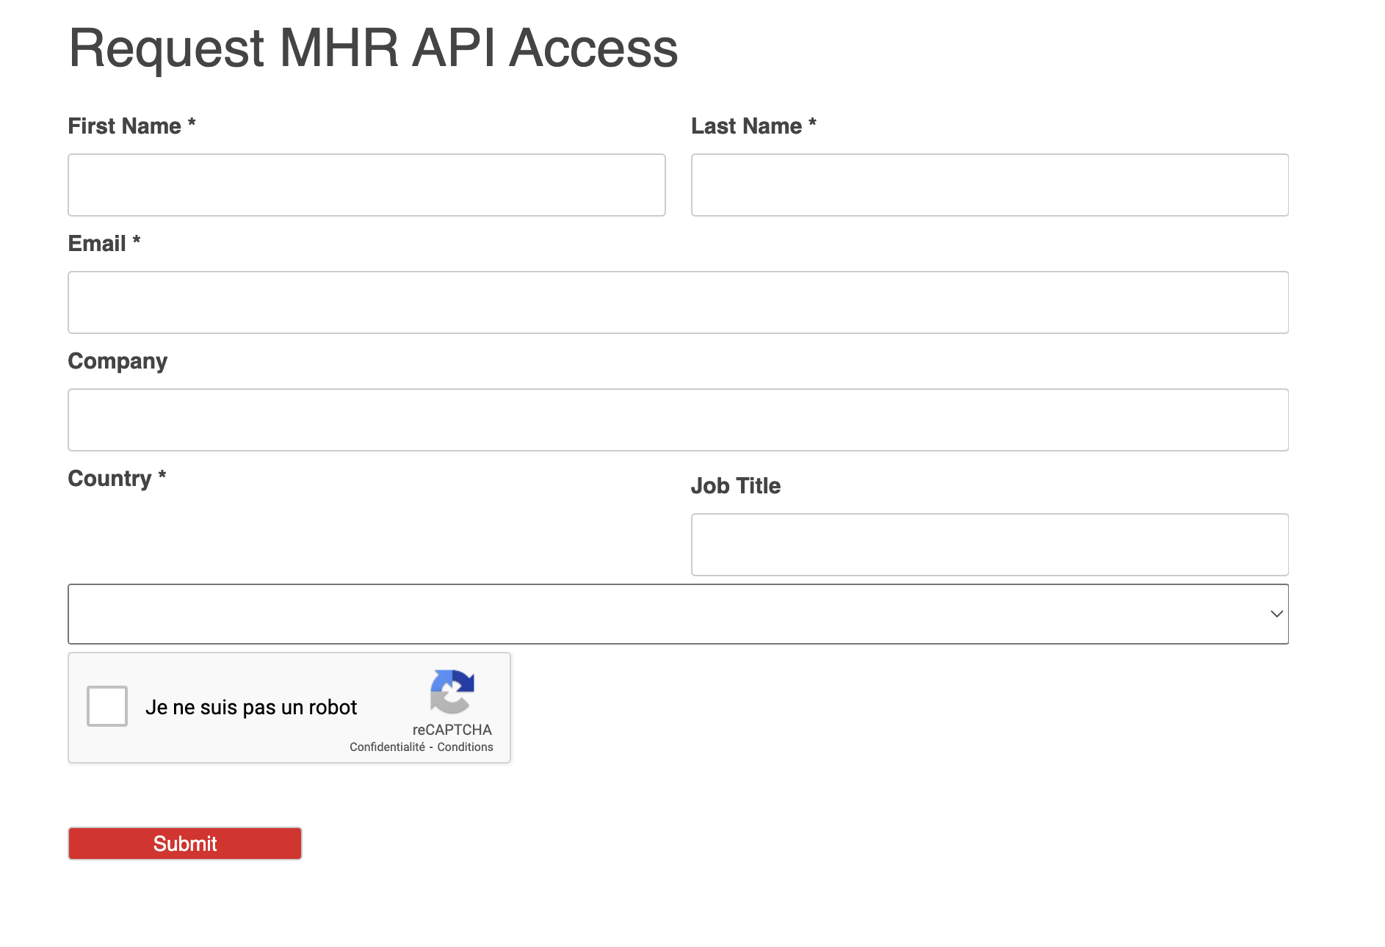

Slide 55
How to implement MHR in your org.
You can use the MHR service via a number of different interfaces:
  Web Interface – This is a very low volume method. You paste your hash into our web interface and we then check our databases and report back to you on the web. https://hash.cymru.com/

Slide 57
How to implement MHR in your org.
We support queries via DNS
  https://hash.cymru.com/docs_dns
  You can formulate a query by using either an A or TXT RR_Type
    For example:
    dig +short 8a62d103168974fba9c61edab336038c.hash.cymru.com TXT
    dig +short 8a62d103168974fba9c61edab336038c.hash.cymru.com A
    The first will return a string Time in EPOCH and a Hit percentage in AV’s
    The second will return a traditional 127.0.0.x depending on if it is found or not
    When doing an A search if you get NXDOMAIN then the hash was NOT FOUND
    When doing a SHA256, you have to break the hash up into two records
  dig +short \ 9b573bc2555d8d35e4a2e927cc14217e.b112f0725cb4ebff4878976a229fde45.hash.cymru.com A

Slide 58
How to implement MHR in your org.
We support queries via WHOIS protocol
  https://hash.cymru.com/docs_whois
  For low volume queries you can use a command line whois
    whois -h hash.cymru.com 84af04b8e69682782607a0c5796ca56999eda6b3
  For higher volume we recommend using GNU NetCat
    With netcat you can create a file that has upto 1000 hashes and submit that via netcat.
    You will get a response back for each hash
    It is important to use the older gnu netcat 0.7.x code

Slide 59
How to implement MHR in your org.
We support a REST API interface as well.
  This interface is great way to integrate into your existing work flows
  Requires specific signup approval
  Permits higher volume / automated queries
  Please let us know what your anticipated query rates so we can plan the infra-structure accordingly.

Slide 60
QUESTIONS ??

Slide 61
CAP – CSIRT Assistance Program

Slide 62
CAP Module Overview
What is the CAP (CSIRT Assistance Program) Service?
What problem(s) are we helping to solve ?
Requirements to signup for the CAP Service.
How to signup for the CAP Service.
How to implement CAP Service on your network.
Questions ?

Slide 63
What is the CAP Service?
CAP = CSIRT Assistance Program
  CSIRT = Computer Security Incident Response Team
A dedicated support program for non-commercial regional and national CSIRT organizations
Free Threat Intel for your region / area of influence
More information:
  https://www.team-cymru.com/csirt-ap

Slide 64
What problem are we helping to solve?
Better visibility into global threat data that impacts your local region.
Leveraging the Team Cymru world-class global threat visibility by sharing detailed information about threats to your community and region.
CSIRT’s don’t always have the visibility to see what is happening elsewhere on the globe and how it impacts their local region.

Slide 65
Requirements to signup for CAP
Must be a recognized non-commercial CSIRT
Must be a regional or national level entity
Must be vetted by our internal team
Must sign a short MOU (Memorandum of Understanding)
Strongly recommend that you have reviewed and follow RFC2350. https://www.rfc-editor.org/rfc/rfc2350

Slide 66
How to signup for CAP
Signing up for CAP is a straightforward and easy process
Goto https://www.team-cymru.com/csirt-ap
Complete the form on the web page.
Be prepared to answer some additional questions from our team as we process your request. Please make sure emails don’t land in your spam folder!

Slide 67
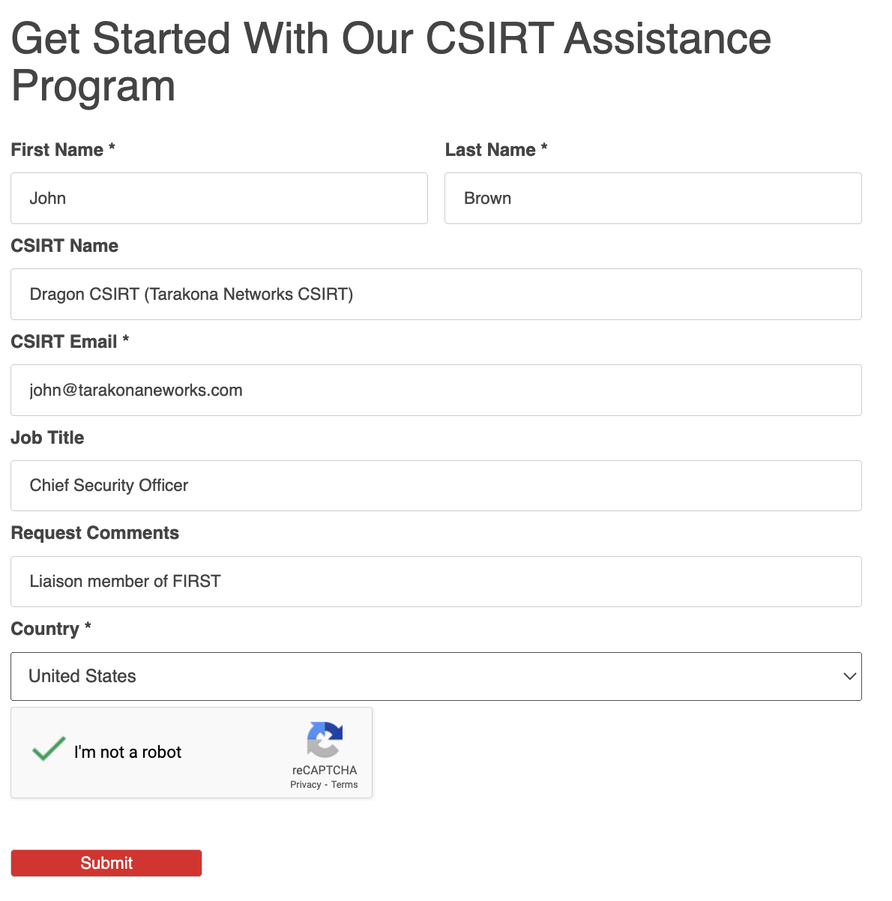

Slide 68
How to implement CAP services
Once you are approved, we recommend that you attend and receive training on our tools.
Develop a process and workflow that integrates the threat data we supply into your existing workflows
Take needed steps to help notify / protect those that are being impacted based on the threat intel provided via the program.
Share data back with Team Cymru so we can leverage it to help other CSIRT’s around the globe.

Slide 69
QUESTIONS ?

Slide 70
Tarek Sendi, Security Evangelist, Team Cymru
Mobile: +216 99 263 218
US office: +1 847 378 3338
Skype: sendi_tarek
Email: tsendi@cymru.com / outreach@cymru.com
@teamcymru
www.team-cymru.com

